Slide 1
Communicating over the Network
Reference Models

Slide 2
Communicating over the Network
Learning Objectives
Describe the structure of a network, including the devices and media that are necessary for successful communications.
Explain the function of protocols in network communications.
Explain the advantages of using a layered model to describe network functionality.
Describe the role of each layer in two recognized network models: The TCP/IP model and the OSI model.

Slide 3
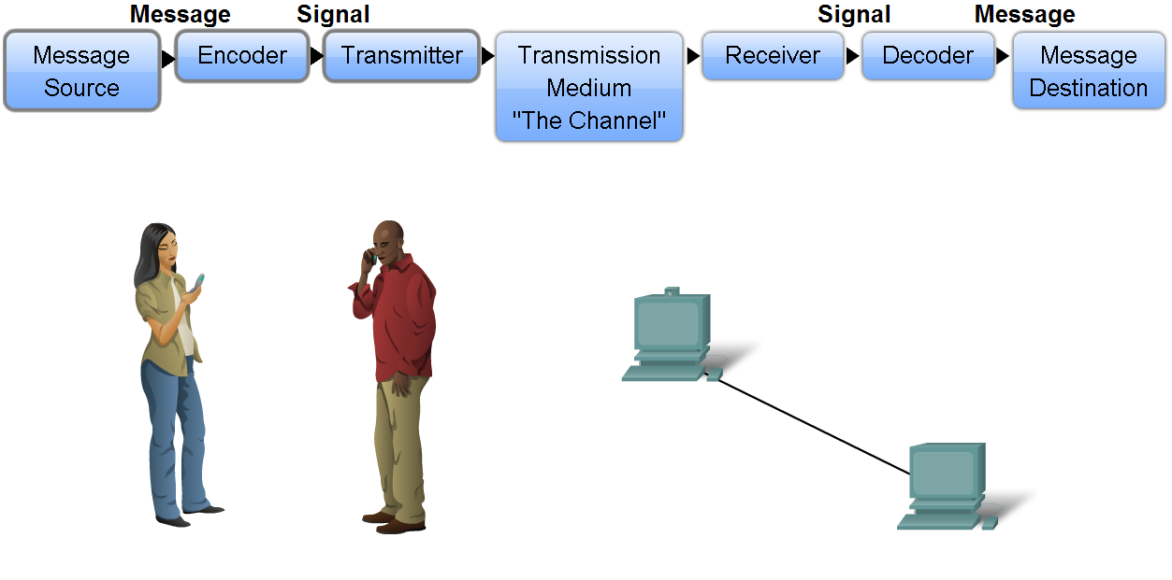
Network Structure
3 common elements of communication:
message source
the channel
message destination
Data or information networks are capable of carrying many different types of communications
Notes:
Communication begins with a message, or information, that must be sent from one individual or device to another. People exchange ideas using many different communication methods. All of these methods have three elements in common. The first of these elements is the message source, or sender. Message sources are people, or electronic devices, that need to send a message to other individuals or devices. The second element of communication is the destination, or receiver, of the message. The destination receives the message and interprets it. A third element, called a channel, consists of the media that provides the pathway over which the message can travel from source to destination.
Consider, for example, the desire to communicate using words, pictures, and sounds. Each of these messages can be sent across a data or information network by first converting them into binary digits, or bits. These bits are then encoded into a signal that can be transmitted over the appropriate medium. In computer networks, the media is usually a type of cable, or a wireless transmission.
The term network in this course will refer to data or information networks capable of carrying many different types of communications, including traditional computer data, interactive voice, video, and entertainment products.

Slide 4
Network Structure
All data frames are broken up into segments allows them to share transmission channel resources:
P1c
P1b
P1a
P2c
P1c
P2b
P1b
P2a
P1a
P2c
P2b
P2a
This process of channel sharing is called multiplexing
Notes:
To improve efficiency, data is divided into smaller, more manageable pieces to send over the network. This division of the data stream into smaller pieces is called segmentation. Segmenting messages has two primary benefits:
First, by sending smaller individual pieces from source to destination, many different conversations can be interleaved on the network. The process used to interleave the pieces of separate conversations together on the network is called multiplexing.
Second, segmentation can increase the reliability of network communications. The separate pieces of each message need not travel the same pathway across the network from source to destination. If a particular path becomes congested with data traffic or fails, individual pieces of the message can still be directed to the destination using alternate pathways. If part of the message fails to make it to the destination, only the missing parts need to be retransmitted.

Slide 5
Network Structure
Hardware (user)
Laptops / Desktops
PDAs
Printers
Interconnecting Media
Copper Cable
Fibre Optic
Wireless
Services
Email
Web-browsers
File sharing
Routing protocols
Hardware (Network)
Hubs / Switches
Routers
Wireless Access Points
Notes:
Services and processes are the communication programs, called software, that run on the networked devices. A network service provides information in response to a request. Services include many of the common network applications people use every day, like e-mail hosting services and web hosting services. Processes provide the functionality that directs and moves the messages through the network. Processes are less obvious to us but are critical to the operation of networks.

Slide 6

Client / Server Processes
Host A
WWW Server
Host B
Host C
Notes:
In the context of a network, end devices are referred to as hosts. A host device is either the source or destination of a message transmitted over the network. In order to distinguish one host from another, each host on a network is identified by an address. When a host initiates communication, it uses the address of the destination host to specify where the message should be sent.
In modern networks, a host can act as a client, a server, or both. Software installed on the host determines which role it plays on the network.
Servers are hosts that have software installed that enables them to provide information and services, like e-mail or web pages, to other hosts on the network.
Clients are hosts that have software installed that enables them to request and display the information obtained from the server.

Slide 7
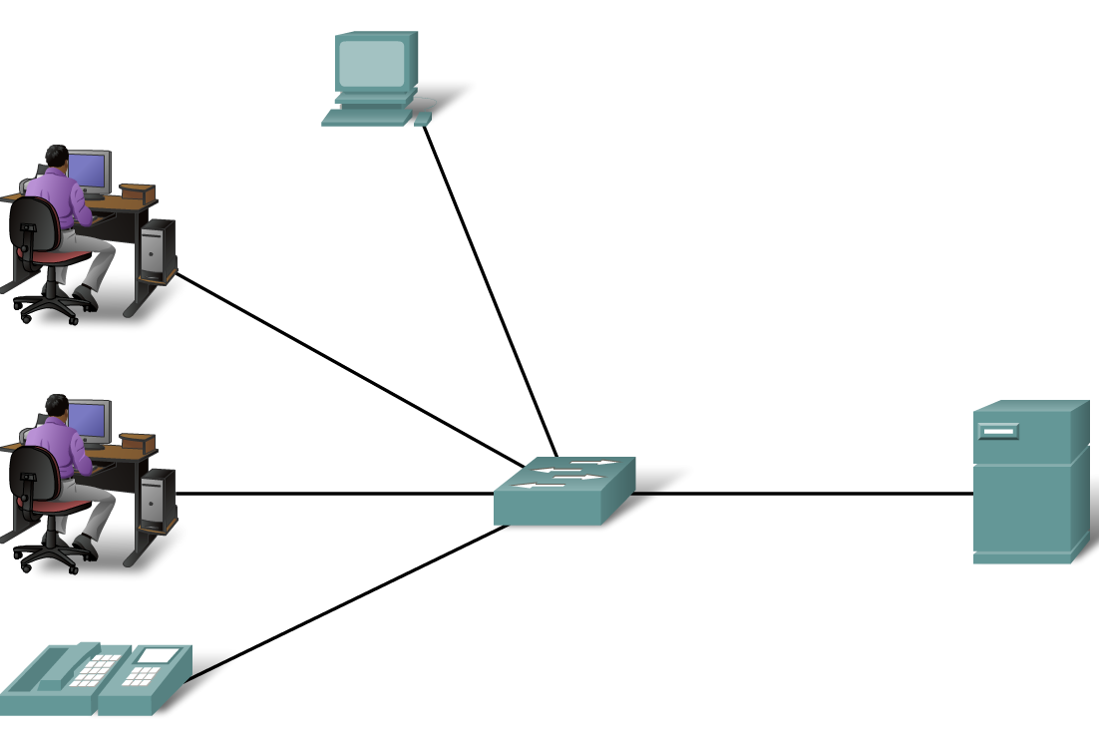
Local Area Networks
(LANs)
A high speed, low-error data network covering a relatively small geographic area (a few thousand meters).
LANS connect workstations, peripherals and other devices in a single building or in a small geographical area.
Notes:
A local area network (LAN) is a computer network covering a small local area, like a home, office, or small group of buildings such as a home, office, or college. Current LANs are most likely to be based on switched Ethernet or Wi-Fi technology running at 10, 100 or 1,000 Mbps (1,000 Mbit/s is also known as 1GBps).
The defining characteristics of LANs in contrast to WANs are:
a) Much higher data rates,
b) Smaller geographic range - at most a few kilometers
c) They do not involve leased telecommunication lines.

Slide 8
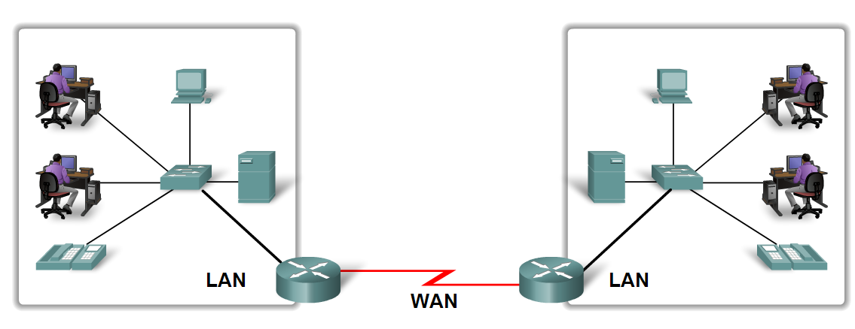
Wide Area Networks
(WANs)
A data communications network that serves users across a broad geographic area and often uses transmission devices provided by common carriers
Notes:
WANs are used to connect LANs together, so that users and computers in one location can communicate with users and computers in other locations.
Many WANs are built for one particular organization and are private. Others, built by ISPs, provide connections from an organization's LAN to the Internet

Slide 9
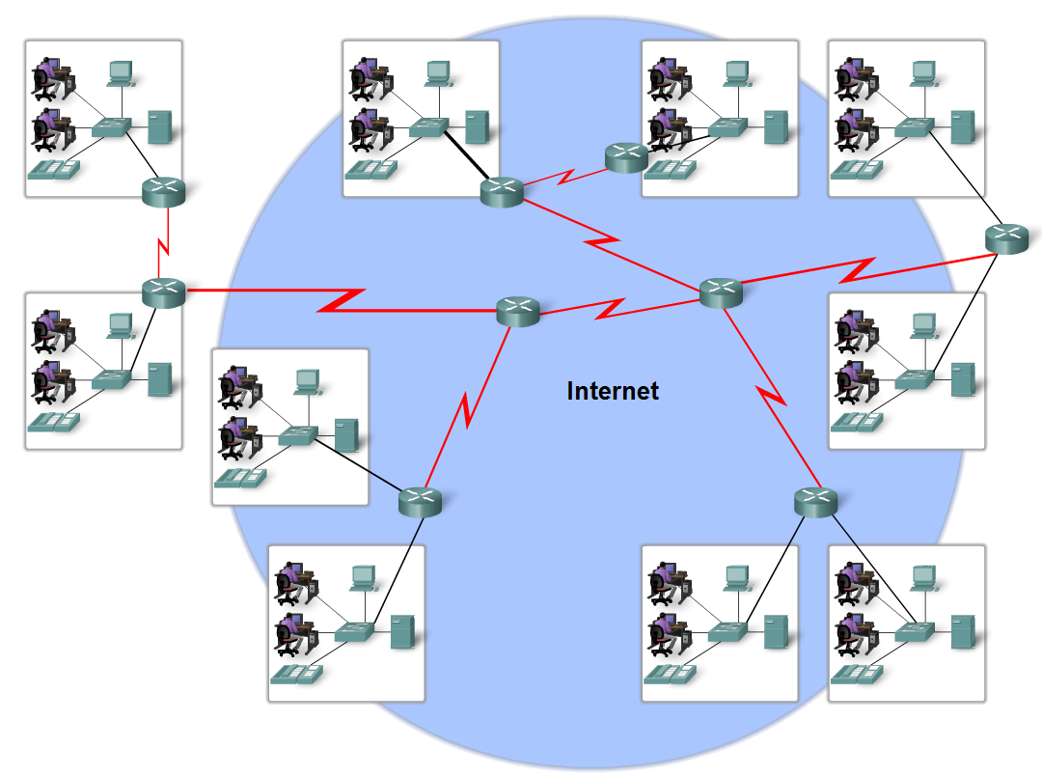
Internetwork
The Internet is created by the interconnection of networks belonging to Internet Service Providers (ISPs).
These ISP networks connect to each other to provide access for millions of users all over the world.
Notes:
An intranet is a private computer network that uses Internet protocols, network connectivity, and possibly the public telecommunication system to securely share part of an organization's information or operations with its employees.
An extranet can be viewed as part of a company's intranet that is extended to users outside the company (eg: normally over the Internet).

Slide 10
Protocols
A Protocol is a formal description of a set of rules and conventions Network protocols provide the following services:
Format or structure of the data
Process which network devices use to share information about pathways to other networks
How and when error and system messages are passed between devices
Set up and termination of data transfer sessions
Notes:
Individual protocols in a protocol suite may be vendor-specific and proprietary. Proprietary, in this context, means that one company or vendor controls the definition of the protocol and how it functions. Some proprietary protocols can be used by different organizations with permission from the owner. Others can only be implemented on equipment manufactured by the proprietary vendor.

Slide 11
Protocols
Network protocols are standardised by a variety of different internationally recognised committees and organisations:
Institute of Electrical and Electronic Engineers (IEEE)
American National Standards Institute (ANSI)
International Telecommunications Union (ITU)
International Standards Organisation (ISO)
Notes:
IEEE – LAN cabling specifications, eg 802.3, 802.5
ISO – 7-Layer Model
ANSI – ASCII, C+, X-Protocols
ITU – WAN standards

Slide 12

Function of Protocols
Hyper Text Transfer
Protocol (HTTP)
Protocol that governs the way that a web server and a web client interact.
Transmission Control
Protocol (TCP)
Divides the HTTP messages into smaller pieces, called segments, to be sent to the destination client.
Internet Protocol
(IP)
Takes the segments from TCP, encapsulates them into packets, assigns appropriate addresses, and selects the best path to the destination host.
Ethernet
Take the packets from IP and format them to be transmitted over the network media.
Data Network
Notes:
An example of the use of a protocol suite in network communications is the interaction between a web server and a web browser.
This interaction uses a number of protocols and standards in the process of exchanging information between them. The different protocols work together to ensure that the messages are received and understood by both parties.

Slide 13
TCP/IP and OSI Model
There are benefits to using a layered model to describe
Network protocols and operations. Using a layered
model:
Assists in protocol design, because protocols that operate at a specific layer have defined information that they act upon and a defined interface to the layers above and below.
Fosters competition because products from different vendors can work together.
Prevents technology or capability changes in one layer from affecting other layers above and below.
.

Slide 14
Layered Model – An Analogy
Ambassador in UK
Ambassador in France
Hello
Bonjour!
Translator
Translator
She is saying hello
The UK ambassador said “Hello”
Secretary
Secretary

Slide 15
Networking model
Application
A
representation of network operation
Application
Presentation
Session
Transport
Transport
Network
Internet
Datalink
Network Access
Physical
Data Network
Notes:
There are two basic types of networking models: protocol models and reference models.
A protocol model provides a model that closely matches the structure of a particular protocol suite. The hierarchical set of related protocols in a suite typically represents all the functionality required to interface the human network with the data network. The TCP/IP model is a protocol model because it describes the functions that occur at each layer of protocols within the TCP/IP suite.
A reference model provides a common reference for maintaining consistency within all types of network protocols and services. A reference model is not intended to be an implementation specification or to provide a sufficient level of detail to define precisely the services of the network architecture. The primary purpose of a reference model is to aid in clearer understanding of the functions and process involved.
The Open Systems Interconnection (OSI) model is the most widely known internetwork reference model. It is used for data network design, operation specifications, and troubleshooting.
Although the TCP/IP and OSI models are the primary models used when discussing network functionality, designers of network protocols, services, or devices can create their own models to represent their products. Ultimately, designers are required to communicate to the industry by relating their product or service to either the OSI model or the TCP/IP model, or to both.

Slide 16
TCP/IP
Application
Represents data to the user, plus encoding and dialogue control
Transport
Supports communication between diverse devices over diverse networks
Internet
Determines the best path through a network
Network Access
Controls the hardware devices and media that make up the network
Data Network
Notes:
The first layered protocol model for internetwork communications was created in the early 1970s and is referred to as the Internet model. It defines four categories of functions that must occur for communications to be successful. The architecture of the TCP/IP protocol suite follows the structure of this model. Because of this, the Internet model is commonly referred to as the TCP/IP model.
Most protocol models describe a vendor-specific protocol stack. However, since the TCP/IP model is an open standard, one company does not control the definition of the model. The definitions of the standard and the TCP/IP protocols are discussed in a public forum and defined in a publicly-available set of documents. These documents are called Requests for Comments (RFCs). They contain both the formal specification of data communications protocols and resources that describe the use of the protocols.
The RFCs also contain technical and organizational documents about the Internet, including the technical specifications and policy documents produced by the Internet Engineering Task Force (IETF)

Slide 17
TCP/IP Encapsulation
As data is passed down the
TCP/IP protocol stack, each layer will add additional header information to the original data.
This process is known
as encapsulation.
Each layer produces a different Protocol Data Unit (PDU)
Application
Transport
Internet
Network Access
Data Network
Notes:
As application data is passed down the protocol stack on its way to be transmitted across the network media, various protocols add information to it at each level. This is commonly known as the encapsulation process.
The form that a piece of data takes at any layer is called a Protocol Data Unit (PDU). During encapsulation, each succeeding layer encapsulates the PDU that it receives from the layer above in accordance with the protocol being used.
At each stage of the process, a PDU has a different name to reflect its new appearance. Although there is no universal naming convention for PDUs, in this course, the PDUs are named according to the protocols of the TCP/IP suite.

Slide 18
TCP/IP Encapsulation
Application Layer
The data created within the application layer is known as a message.
Once completed, it is passed down to the transport layer
Application
Message
Data
Transport
Internet
Network Access
Data Network
Notes:
For this example, assume that the host PC has opened up a web browser, and is attempting to download a web page from a web server on the Internet.
The application layer will support the web browser using the Hyper Text Transfer Protocol (HTTP). This protocol is designed to work with all web browsers, and acts as in interface between the web browser and the networking protocols below the Application layer.
The HTTP message will contain a request for the web server to provide the required web page.

Slide 19
TCP/IP Encapsulation
Transport Layer
Adds a header, containing transport layer information used for controlling communication between hosts.
The PDU is called a Segment.
Application
Segment
Transport
Data
TCP Header
Internet
Network Access
Data Network
Notes:
The HTTP request message is handed to the Transport layer. There the application data is broken into multiple segments using the Transmission Control Protocol (TCP). Each segment will have a TCP header added, which contains information about the identity of the segment, flow control information, the identity of the originating protocol (HTTP)
Each TCP segment is given a label, called a header, containing information about which process running on the destination computer should receive the message. It also contains the information to enable the destination process to reassemble the data back to its original format.

Slide 20
TCP/IP Encapsulation
Internet Layer
The segment from the transport layer is passed to the internet layer which adds an additional IP header allowing end-to-end connectivity.
This produces a PDU called a packet.
Application
Transport
Packet
Internet
Segment
IP Header
Network Access
Data Network
Notes:
The Transport layer segment moves to the Internet layer, where the Internet protocol (IP) is implemented. Here the entire TCP segment is encapsulated within an IP packet, which adds another label, called the IP header.
The IP header contains source and destination host logical IP addresses, as well as a protocol identity information necessary to deliver the packet to TCP at the receiving web server.

Slide 21
TCP/IP Encapsulation
Network Access Layer
Packet is passed to the Network Access layer, which adds a header and trailer to produce a frame.
Header contains physical address information, whilst the trailer provides an error checking function.
This is then encoded, before being fed to the network transmission media as a bit stream
Application
Transport
Internet
Frame
Network Access
Error Check
Packet
Physical Address
0
0
1
1
0
1
0
1
Data Network
Notes:
Next, the IP packet is sent to the Network Access layer where it is encapsulated within a frame header and trailer. Each frame header contains a source and destination physical address. The trailer use a CRC error check to allow for data integrity checking.
Finally the bits are encoded onto the transmission by the network card (NIC). The encoding might be Manchester , NRZ-I, etc, depending on the NIC and transmission media.

Slide 22
TCP/IP De-encapsulation
Web Server
Network Access Layer
The destination web server will receive the bit stream, and then re-build the original frame.
The physical address in the header is checked to see if the frame is for the web server. If it is, the header is removed.
The error check is then performed to check for data corruptions. If the CRC detects errors, the whole frame is discarded. If the frame is good, the CRC trailer is removed.
Application
Transport
Internet
Network Access
Frame
0
0
1
1
0
1
0
1
Error Check
Packet
Physical Address
Data Network
Notes:
The web server will first check the header field to see if its own address is held in the destination field. This means that the frame is intended for the web server.
The Web server then performs a CRC calculation of the whole frame. If the result does not match the CRC attached to the frame, then the frame is rejected.
Once the header and trailer information has been read, both are deleted, and the resultant packet is handed to the Internet layer.

Slide 23
TCP/IP De-encapsulation
Web Server
Internet Layer
The packet recovered from the network access layer is examined by the IP protocol.
IP checks the header to see if the logical address information is correct.
The IP header is then deleted, and the segment is passed to TCP.
Application
Packet
Transport
Segment
IP Header
Internet
Network Access
Data Network
Notes:
The packet recovered from the network access layer is handed to the Internet layer. IP examines the header on the packet, and checks that the web server logical address is held in the destination address field. If it is, the packet is accepted, if not, it is rejected.
IP then checks to see which transport layer protocol is being carried by the segment. In this case, it is TCP, so IP now deletes the IP header, and hands the segment to TCP in the transport layer.

Slide 24
TCP/IP De-encapsulation
Transport Layer
The segment recovered from the Internet layer is examined by the TCP protocol.
TCP checks the header, and performs any transport layer tasks required.
The TCP header is then deleted, and the data is passed to the application layer.
Web Server
Application
Segment
Data
TCP Header
Transport
Internet
Network Access
Data Network
Notes:
TCP checks the header information, and acts upon the information held within. Remember that TCP may have to perform resequencing of the segments, flow control, or ask for a retransmission if a segment has not been received.
TCP will also check in the header to see which application layer protocol is being carried by the segment. In this case, as it is a web page request, the protocol will be identified as HTTP.
Once TCP has performed its required functions, the TCP header is deleted, and the data is handed to the HTTP protocol.

Slide 25
TCP/IP De-encapsulation
Application Layer
The data recovered from the Transport layer is handed to the required Application layer protocol.
As this example is a web page request, the data is given to HTTP.
HTTP passes the web request data to the web server operating system.
Web Server
Application
Message
Data
Transport
Internet
Network Access
Data Network
Notes:
As this example illustrates a web page request, the Transport layer hands the recovered data to the HTTP protocol in the Application layer.
HTTP acts as an interface between the web server operating system and the networking protocols.
HTTP passes the data to the web server operating system. The whole process know restarts, as the web server will have to respond to the requesting PC by sending the requested web page.

Slide 26
OSI Model
The standard seven-layer model for network protocol architecture, represents an effort by the International Standards Organisation, (ISO) to standardise the design of network protocols to promote interconnectivity
Data Network

Slide 27
OSI – TCP/IP
Comparison
Application
Application
Presentation
Session
Transport
Transport
Network
Internet
Datalink
Network Access
Physical
Data Network
Notes:
At the Network Access Layer, the TCP/IP protocol suite does not specify which protocols to use when transmitting over a physical medium; it only describes the handoff from the Internet Layer to the physical network protocols. The OSI Layers 1 and 2 discuss the necessary procedures to access the media and the physical means to send data over a network.
The key parallels between the two network models occur at the OSI model Layers 3 and 4. OSI Model Layer 3, the Network layer, almost universally is used to discuss and document the range of processes that occur in all data networks to address and route messages through an internetwork. The Internet Protocol (IP) is the TCP/IP suite protocol that includes the functionality described at Layer 3.
Layer 4, the Transport layer of the OSI model, is often used to describe general services or functions that manage individual conversations between source and destination hosts. These functions include acknowledgement, error recovery, and sequencing. At this layer, the TCP/IP protocols Transmission Control Protocol (TCP) and User Datagram Protocol (UDP) provide the necessary functionality.
The TCP/IP Application layer includes a number of protocols that provide specific functionality to a variety of end user applications. The OSI model Layers 5, 6 and 7 are used as references for application software developers and vendors to produce products that need to access networks for communications.

